Slide 1
2023 Cola-Lab Study Group
BO With Conformal Prediction
Shengbo Wang

Slide 2
Conformal Prediction: Uncertainty Quantification
90% confidence level for three different images.
The Goal of CP:
What we have to do (dataset splitting):
Training set
Create a model and determine the parameters.
Dataset
Holdout set
Compute the score and output the uncertainty of prediction.

Slide 3
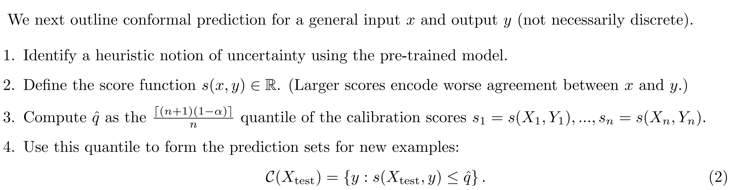
Conformal Prediction for Classification

Slide 4
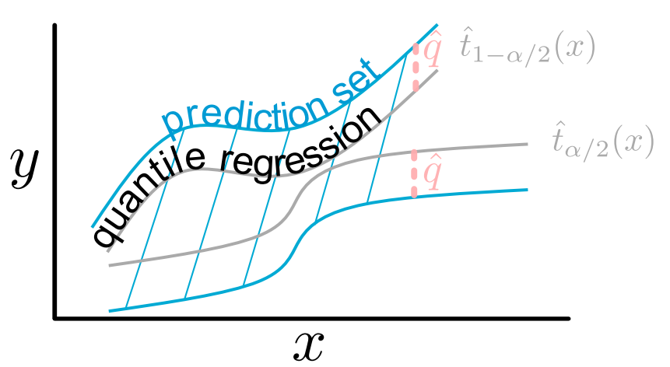
Conformal Prediction for Regression
The calculation of CP for regression problem is much more complex due to discretization!

Slide 5
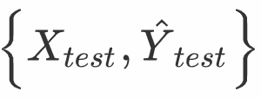
Bayesian Conformal Computation and Full CP
With holdout dataset:
Without holdout dataset:
Training a model: fitting + where
If the model updates, e.g. by gradient descent, the calculation is rather complex O(kn).
Bayesian Computation: 0(n)
Bayesian Computation on full dataset : (numerically instable)

Slide 6
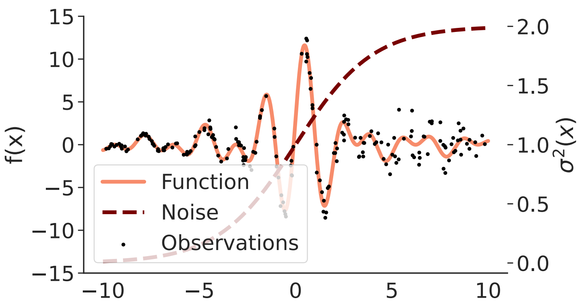
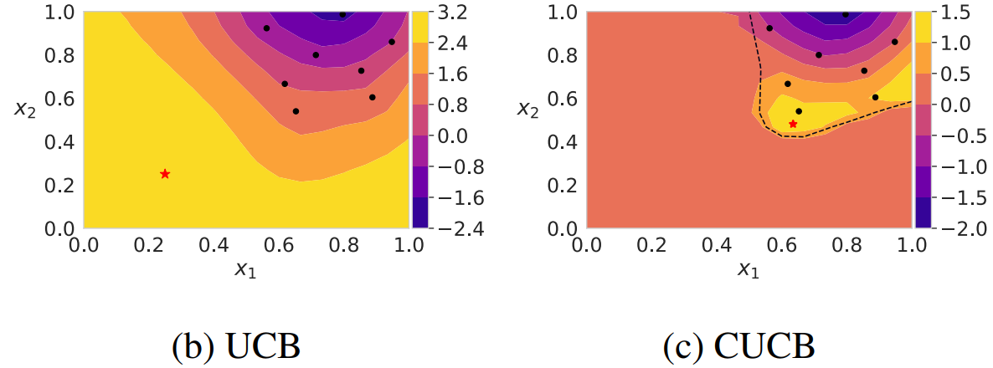
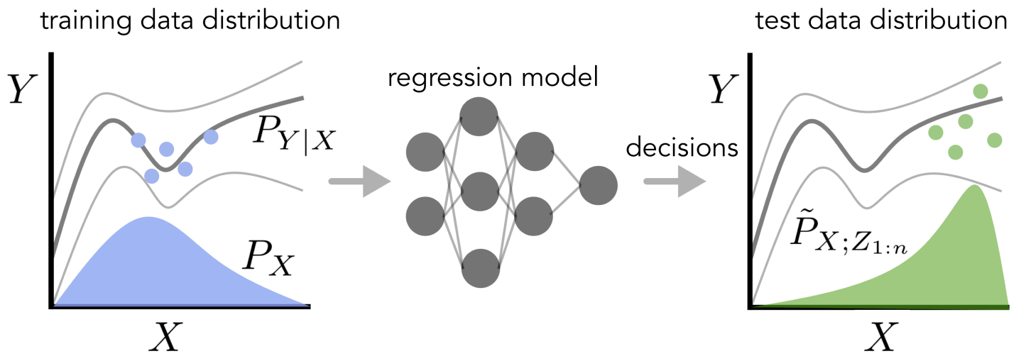
BO with CP set
Model misspecification
Covariate shift
Serve as “trust region”:
Samuel Stanton, Wesley Maddox, Andrew Gordon Wilson. Bayesian Optimization with Conformal Prediction Sets, AISTATS 2023.

Slide 7
Covariate shift
Pseudo-exchangeable:
CP with pseudo-exchangeable dataset:
Tibshirani, R. J., Foygel Barber, R., Candes, E., and Ramdas, A. (2019). Conformal prediction under covariate shift. NeurIPS 2019.

Slide 8
GP Model with CP
Score: using full Bayesian computation, address the unstable computation of variance.
Differentiating: using sigmoid instead of step function.
Discretization: sampling from instead of gridding in objective space.
Observation: CP-based prediction coverages better than credible set of a GP model.

Slide 9
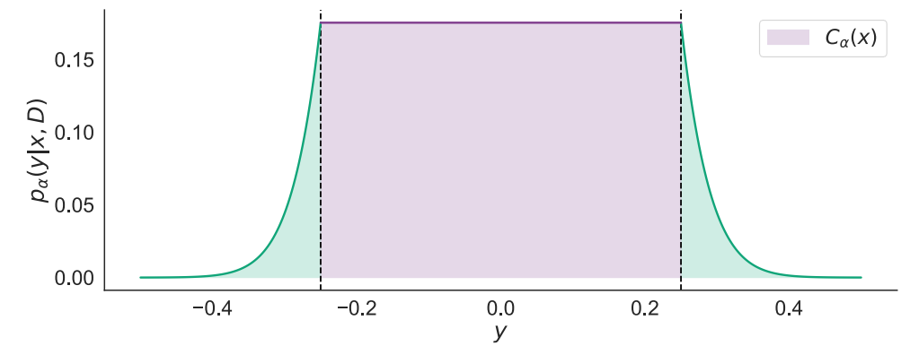
Acquisition function
Expected-utility-based AF in BO:
Calibrated model prediction by CP: (when α=1, CP prediction = GP prediction)
Some AFs:
Calculating the value of AF: Monte Carlo integration

Slide 10
Results
Empirical coverage: conformal prediction provides much more consistent coverage
BO under Model misspecification: better sample efficiency

Slide 11
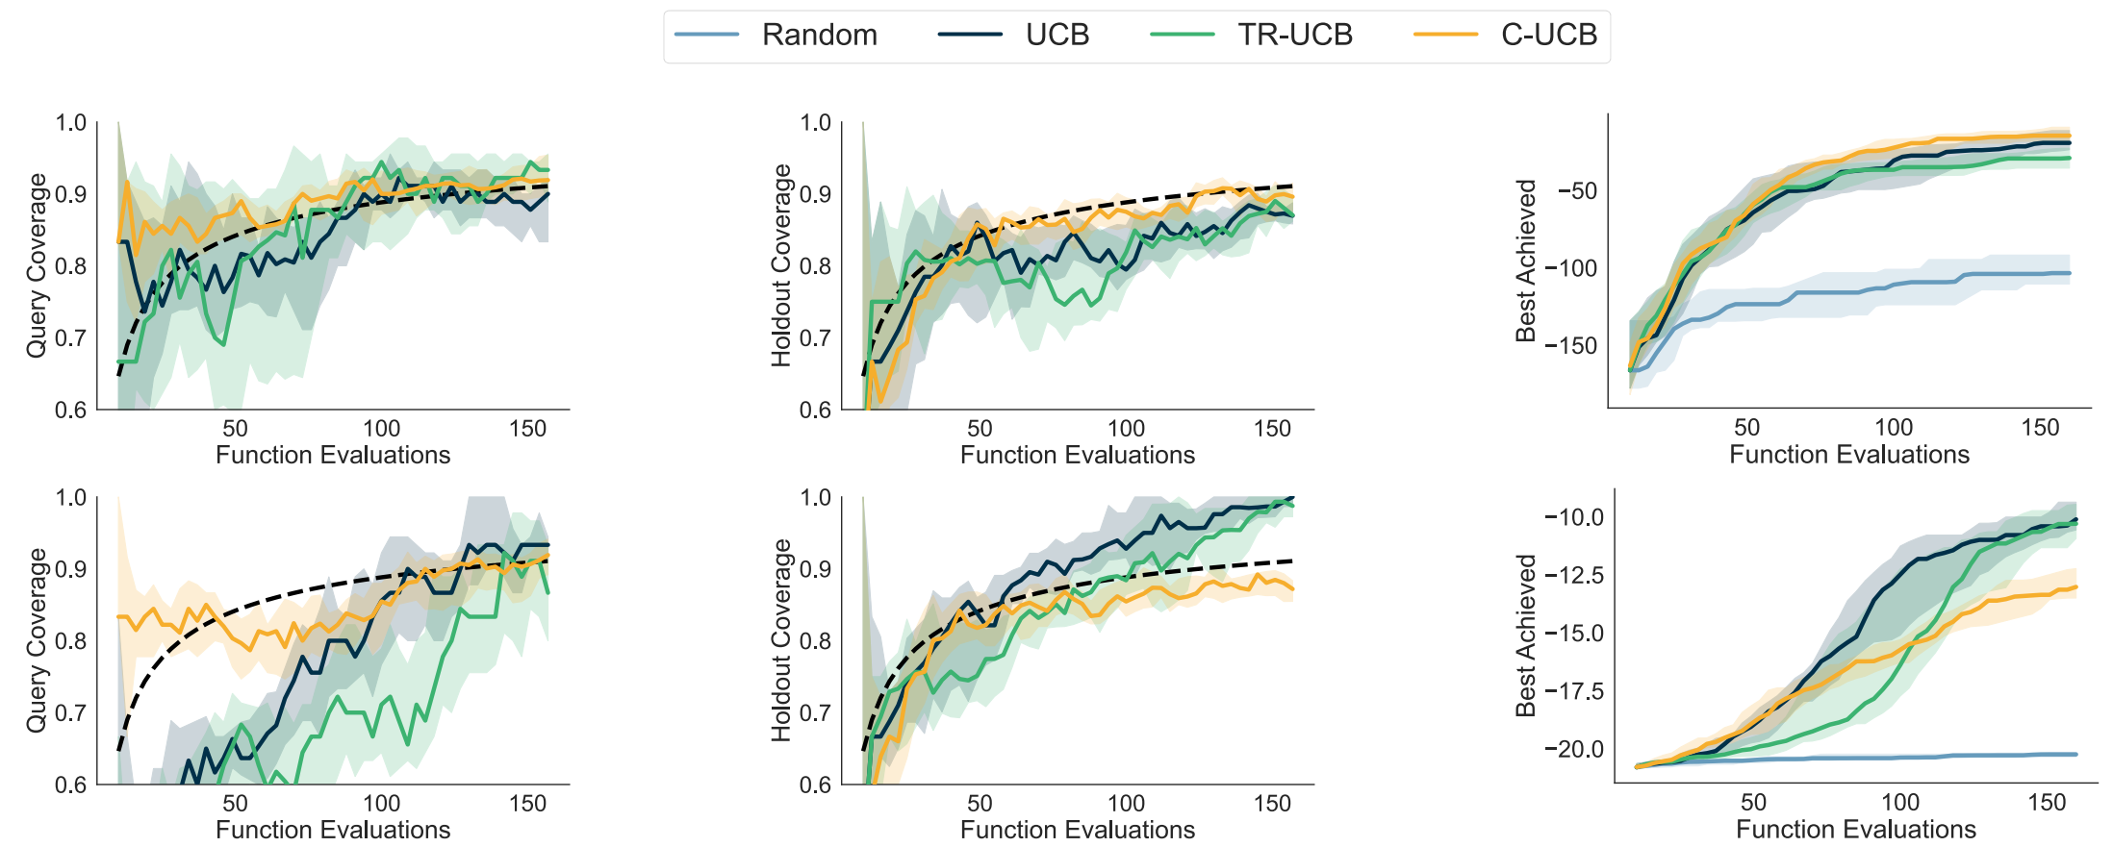
Results
Coverage during BO:
reliable querying solutions
improve query coverage without harming sample efficiency

Slide 12
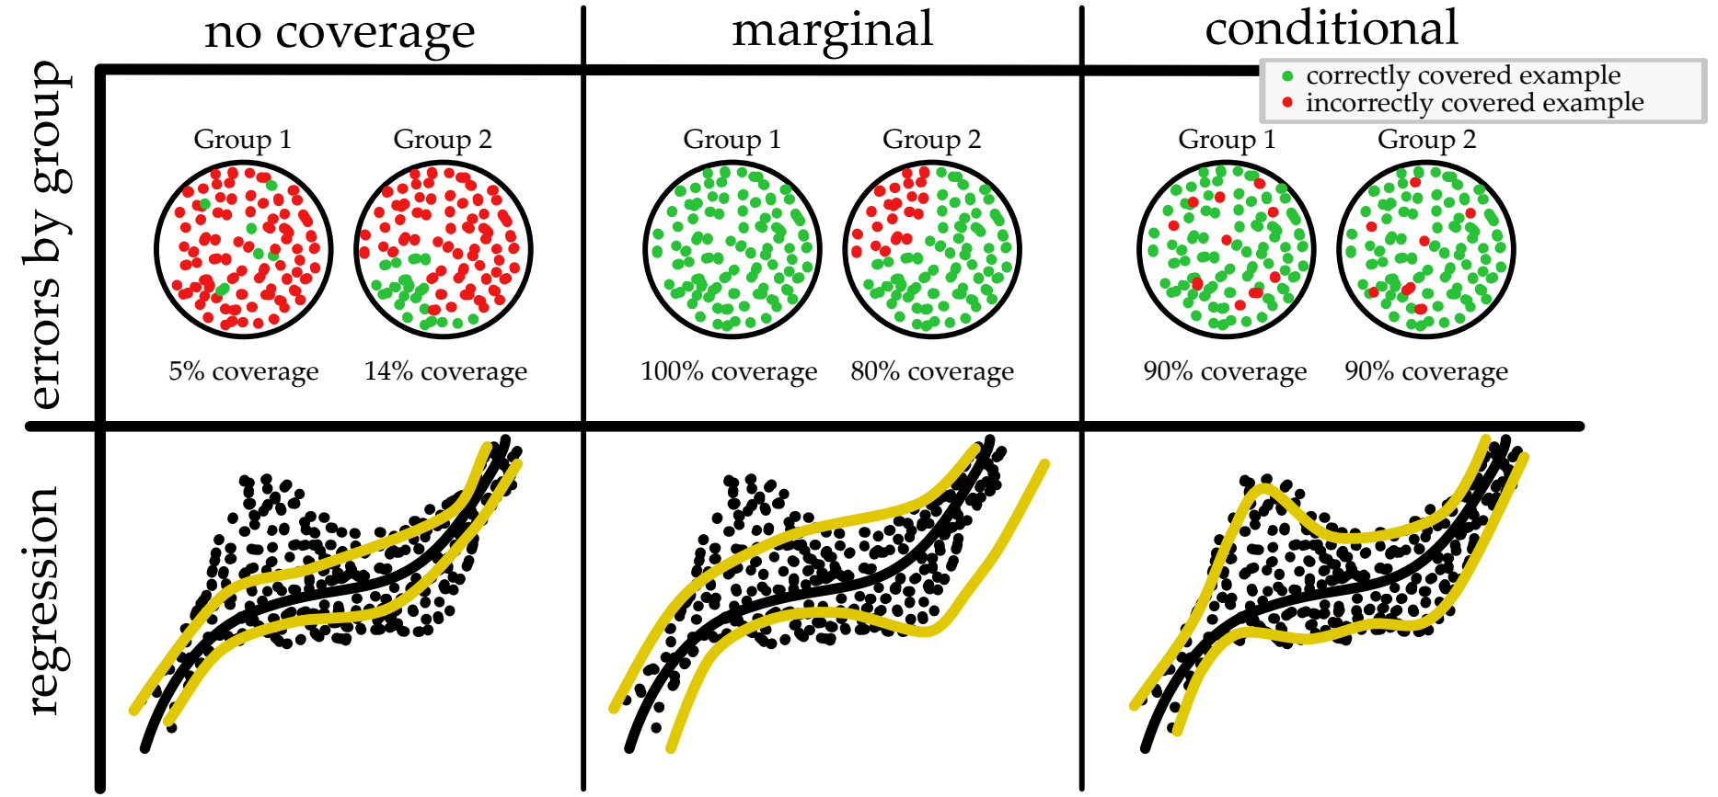
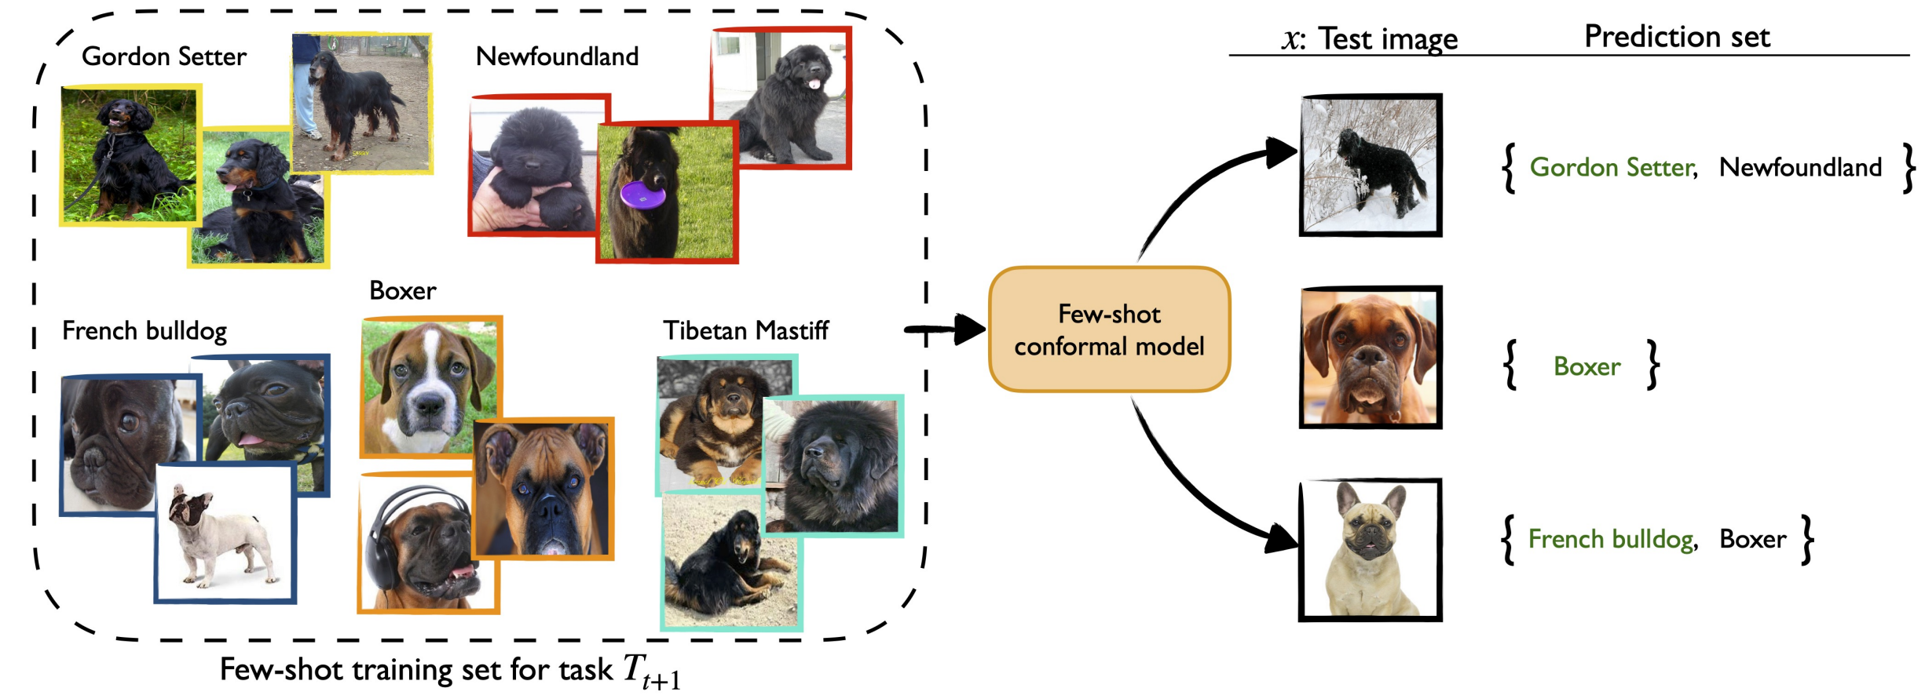
Discussion
Limitations
Approximation error: grid vs. posterior sampling, sigmoid relaxation, density-ratio…
Complexity: Monte Carlo, unstable prediction…
Marginal coverage vs. conditional coverage
Further investigations
Different models and applications
Meta-CP for life-long BO
Adam Fisch, Tal Schuster, Tommi Jaakkola, Regina Barzilay. Few-shot Conformal Prediction with Auxiliary Tasks, ICML 2021.

Slide 13
Thanks!
Shengbo Wang

